Slide 1
Banking Customers insights Dashboard

Slide 2
Project Overview
Built using Advanced Excel and Microsoft Power BI
ETL pipeline with Power Query Editor (PQE)
Goal: Transform raw banking data into actionable insights

Slide 3
Problem Statement
Banks face challenges in analyzing customer behavior
Risk prediction is difficult due to scattered data
Need for clear KPIs and segmentation to support decision‑making

Slide 4
Dataset Information
Source: Kaggle banking dataset Size: ~3,000 rows
Attributes: Customer demographics, transactions, domains, locations
Preprocessing: Cleaning in Excel, transformation in PQE

Slide 5
Tools and Technologies Used
Advanced Excel → Data cleaning, preprocessing
Power BI Desktop → Dashboard creation, KPI visualization
Power Query Editor (PQE) → ETL pipeline for structured transformation

Slide 6
Dashboard Preview
KPI Cards: Total Value, Transactions, Avg Transaction Value
Charts: Value by Location, Domain Contribution %, Transaction Growth %
Map: Geographic distribution of values
Customer Segmentation Matrix

Slide 7
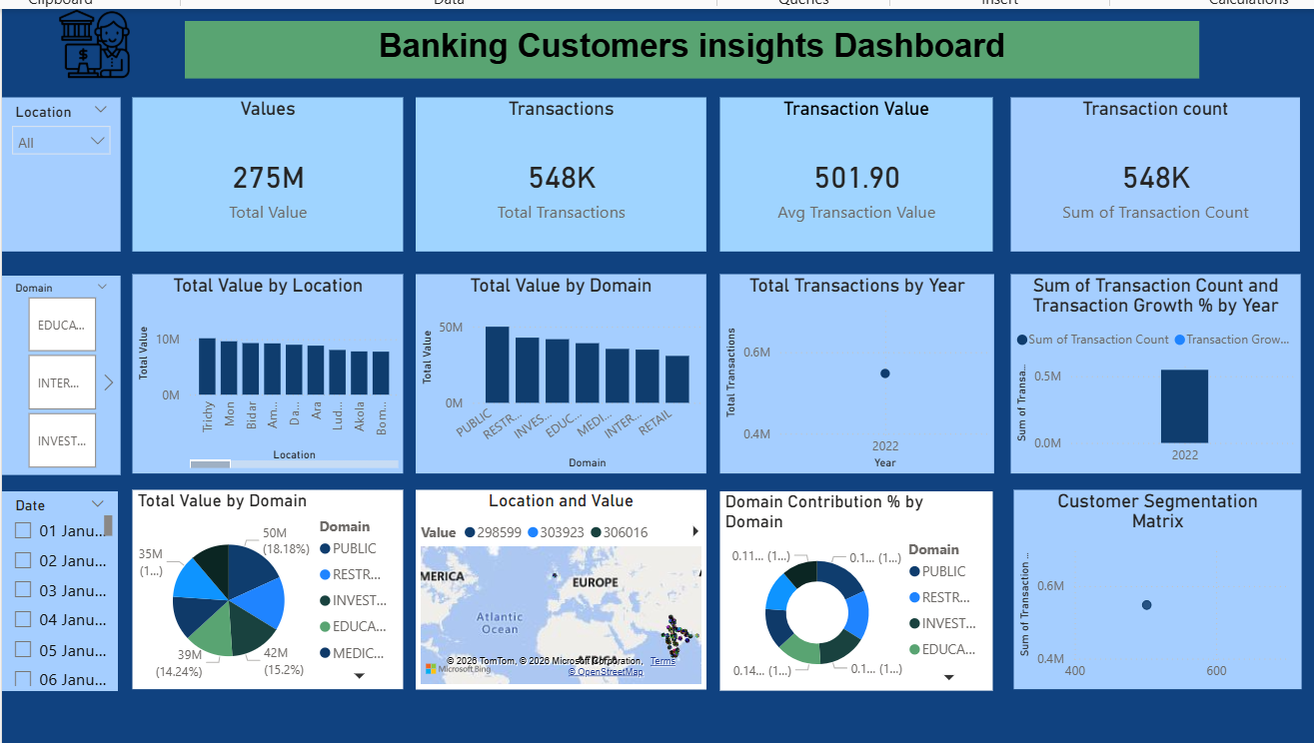
Dashboard Preview

Slide 8
Future Enhancements
Add predictive analytics (loan default risk modelling)
Integrate real‑time data streams
Expand dataset for multi‑year analysis
Deploy dashboard via Power BI Service for online access

Slide 9
Conclusion
Dashboard provides data‑driven insights into banking customers
Helps reduce risk and improve retention
Demonstrates integration of Excel + Power BI for professional analytics
Ready for portfolio showcase and recruiter review

